Slide 1
DEPLOYEMENT OF SERVICES IN AWS
V.NITHISHA

Slide 2
LINUX EC2 INSTANCE :
There are two ways to connect :
Click on start lab to start the lab session.
To get connected to the AWS console click on the AWS link above the terminal.
Click on services present at the top left and click compute then click on EC2.
From EC2 dashboard select Instances and click on Launch Instance.
Name an instance and create a key-pair and click on launch instance.
After successful creation select the instance that you created and select the Action drop down menu and click on connect.
We get connected to a Amazon Linux.
Click on end lab.

Slide 3
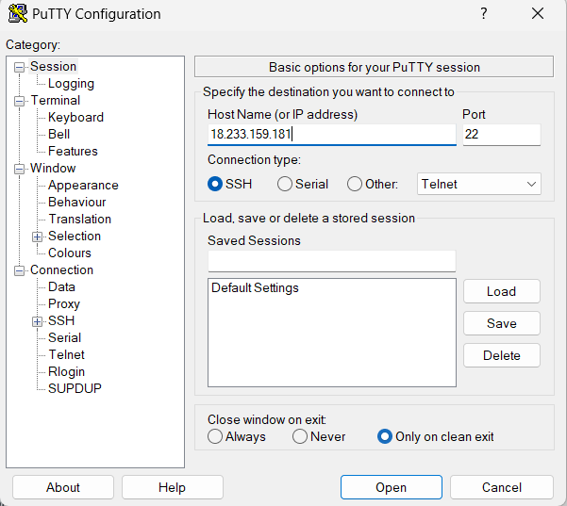
Other Process:
Open Putty, give host name(Public IP address) present in the connect Instance
Now click on connections next select SSH and click Auth within SSH and then select Credentials.
A window will open on right side click on browse and select the ppk file that you downloaded and click on open.

Slide 4
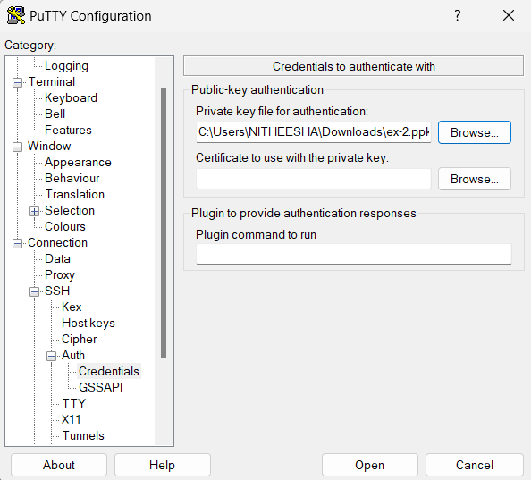
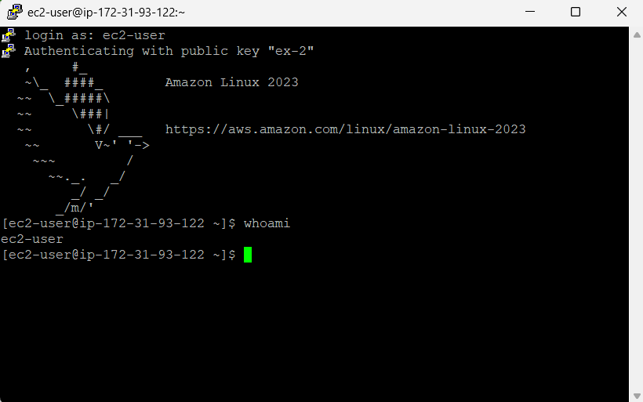
Amazon Linux will open

Slide 5
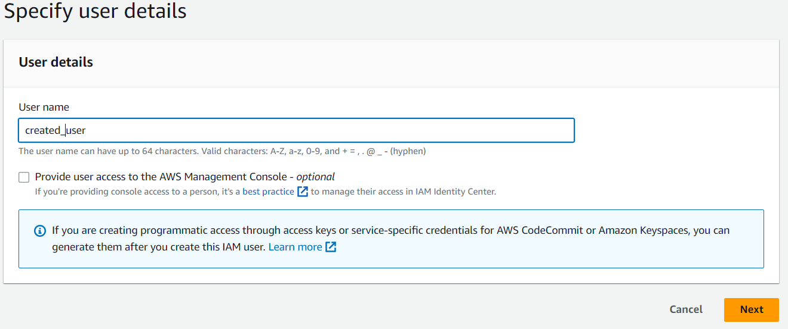
IDENTITY AND ACCESS MANAGEMENT(IAM):
In the AWS Management Console, on the Services menu, select IAM.
In the navigation pane on the left, choose Users.
Now click on add users
Give the user name and click on next, next, and create user

Slide 6
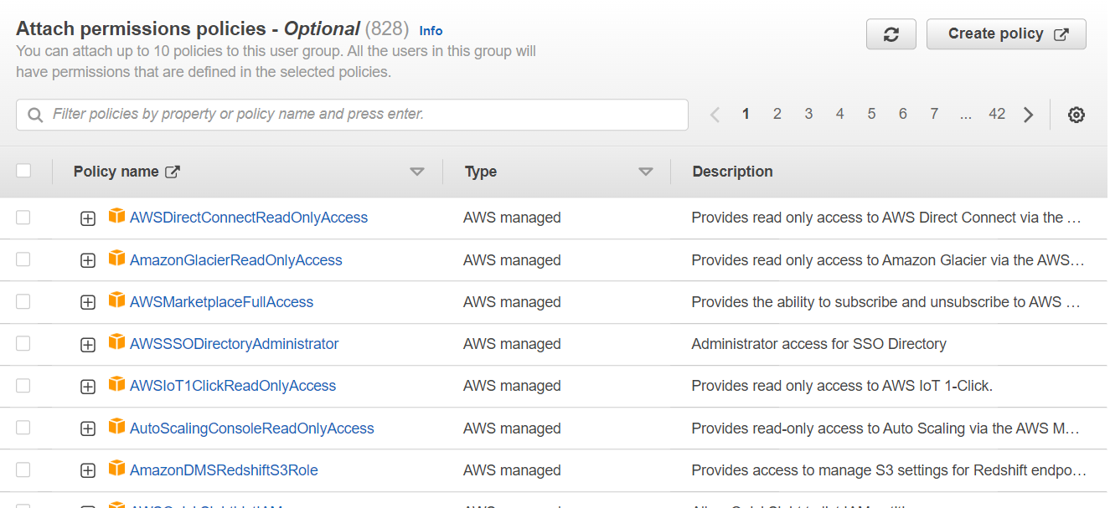
User successfully created message will be displayed.
Now for creating groups from the left pane select user groups.
Click on create group and give the group name.
Now also attach the permissions that you want to give to users of the group you created.
Now click on create group and then you will see a pop up for successful creation of group

Slide 7
Now you can add users to the group you created by clicking on add users.
Now select the users you want to add into group and click on add users.
Finally you will see the pop for successfully adding user to the group

Slide 8
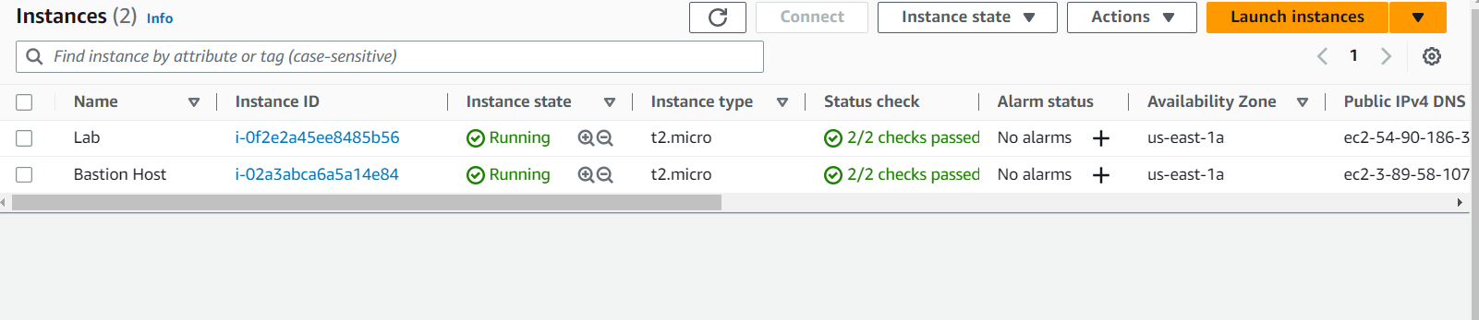
Elastic Block Store :
In the AWS Management Console, on the Services menu, click EC2.
In the left navigation pane, choose Instances.
An Amazon EC2 instance named Lab has already been launched for your lab.
In the left navigation pane, choose Volumes.
Choose Create Volume then configure:
Volume Type : General purpose SSD (gp2)
Availability Zone: Select the same availability zone as your EC2 instance.

Slide 9
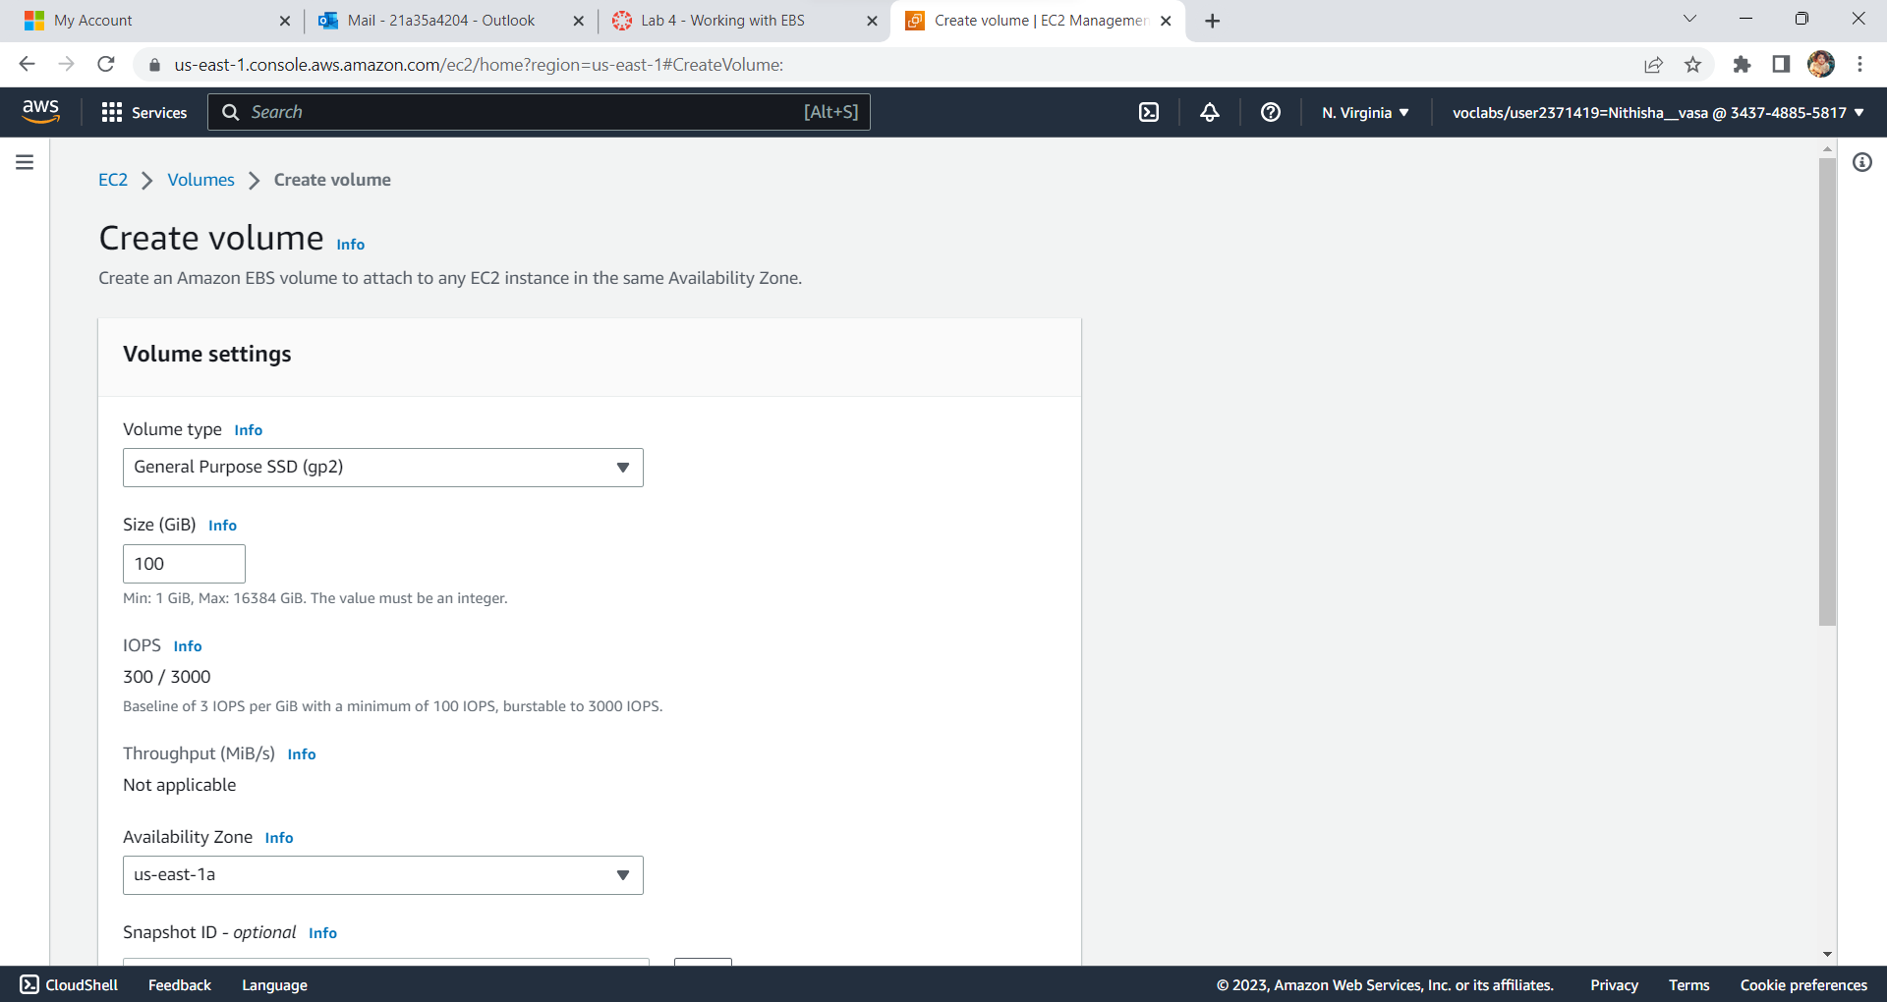
Choose Add Tag
In the tag editor, enter:

Slide 10
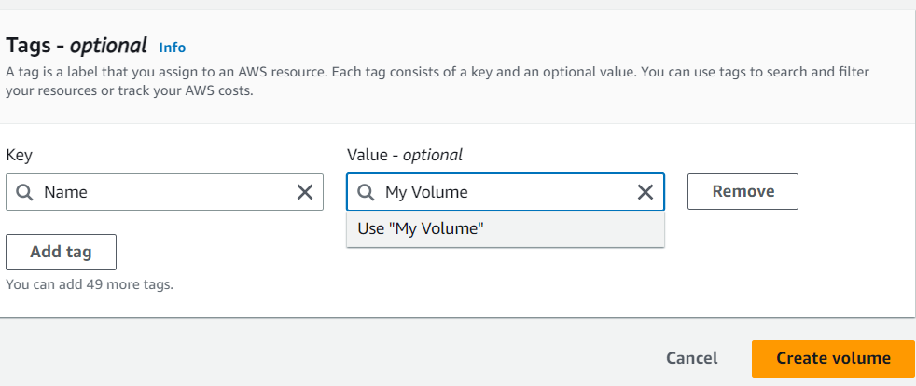
Key : Name
Value : My Volume
Choose create Volume
Select My Volume.
In the Actions menu, choose Attach volume.

Slide 11
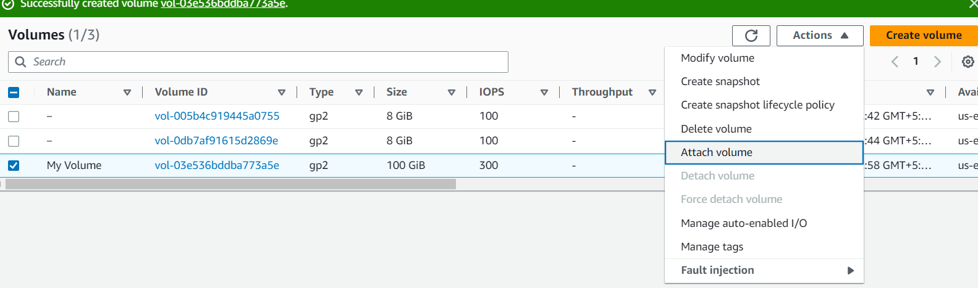
Choose the Instance field, then select the instance that appears (Lab).
Note that the Device field is set to /dev/sdf. You will use this device identifier in a later task.
Choose attach Volume.

Slide 12
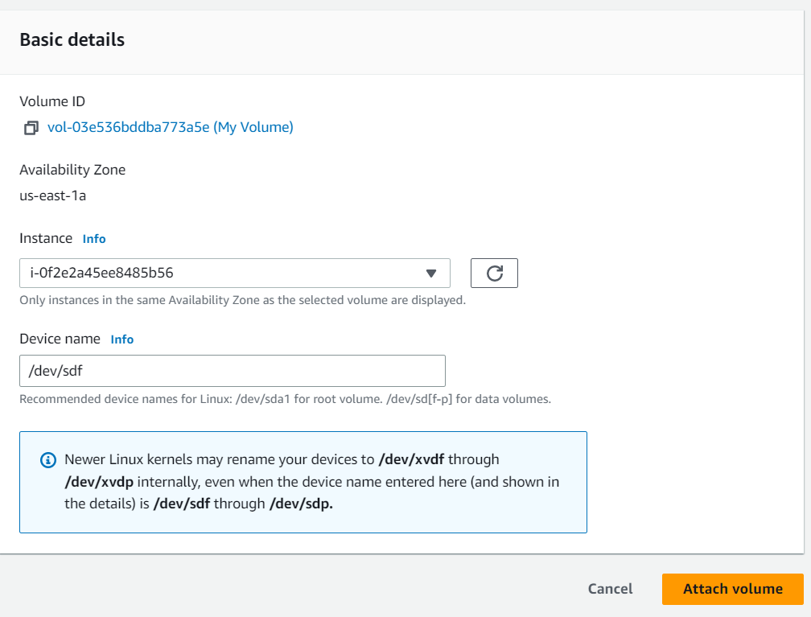
Volume attached successfully

Slide 13
Virtual Private Cloud :
From services select VPC and click on create VPC
choose VPC and more
keep autogenerated selected and give the name for your VPC
For number of availability zones select 1
For the number of public subnets select 1
For the number of private subnets select 1
Expand Customize subnets CIDR blocks and change the public subnet CIDR block in us-east-1a to 10.0.0.0/24 and change the private subnet CIDR block to 10.0.1.0/24
Set NAT gateways to In 1 AZ.
Set VPC endpoints to None.
Keep both DNS hostnames and DNS resolution enabled.
Now click on create VPC and click on view VPC.

Slide 14
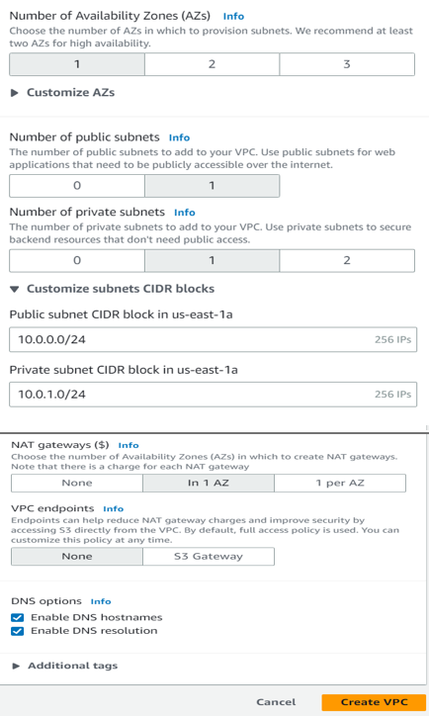

Slide 15
Now for creating subnets click on subnets from the dashboard and click on create subnet.
for VPC-ID select project-vpc , name the subnet.
For availability zone select the second availability zone us-east-1b.
And give the ipv4 CIDR block and then click on create subnet.
Now create another subnet that is private subnet in the second availability zone using a similar approach.
In the left navigation pane, choose Route tables.
Select the project-rtb-private route table.
Choose the Subnet associations tab.
In the Explicit subnet associations panel, choose Edit subnet associations.
Leave project-subnet-private1-us-east-1a selected, but also select project-private-subnet2.
Then click on save associations

Slide 16
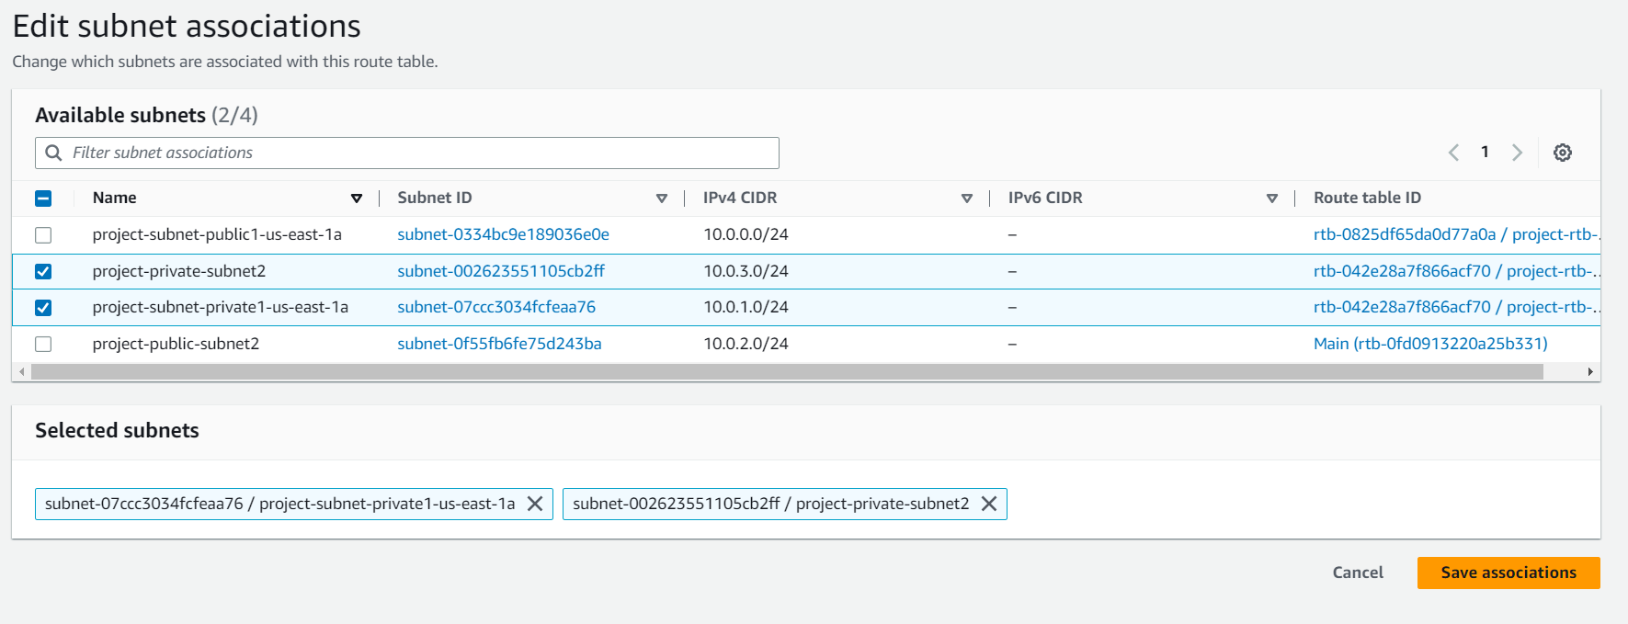
In the left navigation pane, choose Security groups.
Choose Create security group and then configure:
Give a name to the security group.
Description: Enable HTTP access.
VPC: from the drop-down list choose project-VPC.

Slide 17
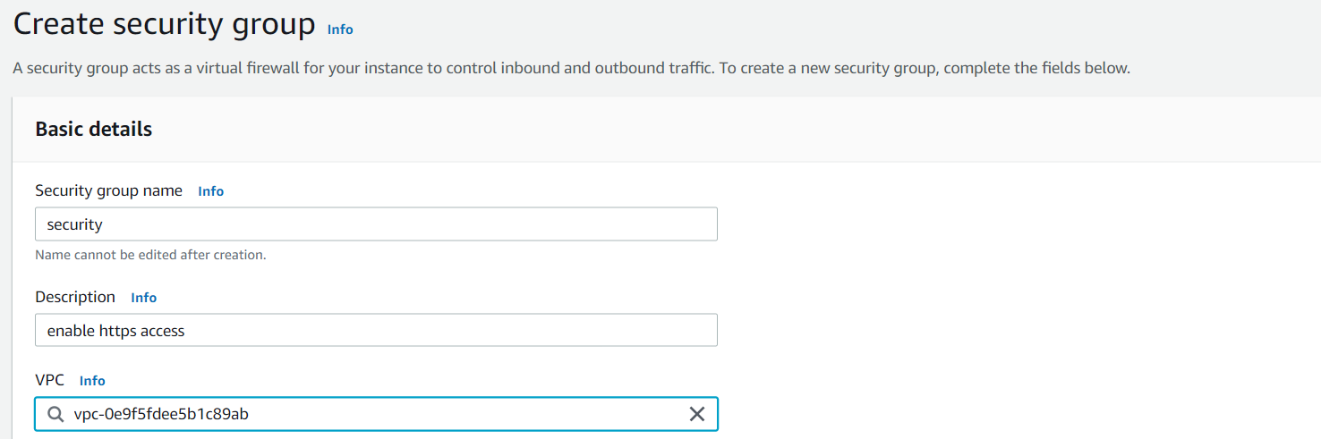
In the Inbound rules pane, choose Add rule.
Configure the following settings:
Type: HTTP
Source: Anywhere-IPv4
Description: Permit web requests

Slide 18
Scroll to the bottom of the page and choose create security group.
Now create an amazon Linux EC2 instance.
while creating configure the network settings.
Select the network as project-VPC.
Select the project-private-subnet2 as subnet.
And enable auto IP.
Under firewall select the existing security group and select the created security group i.e security.
In the Configure storage section, keep the default settings.
Launch the instance.
C

Slide 19
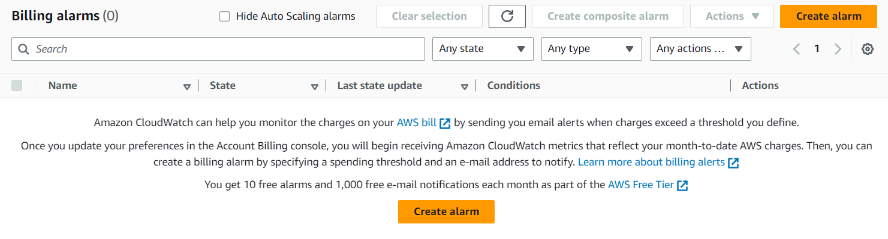
CLOUD WATCH :
From services select cloud watch.
From the dashboard on the left pane select billing.
Click on create alarm.
Now edit the metrics.

Slide 20
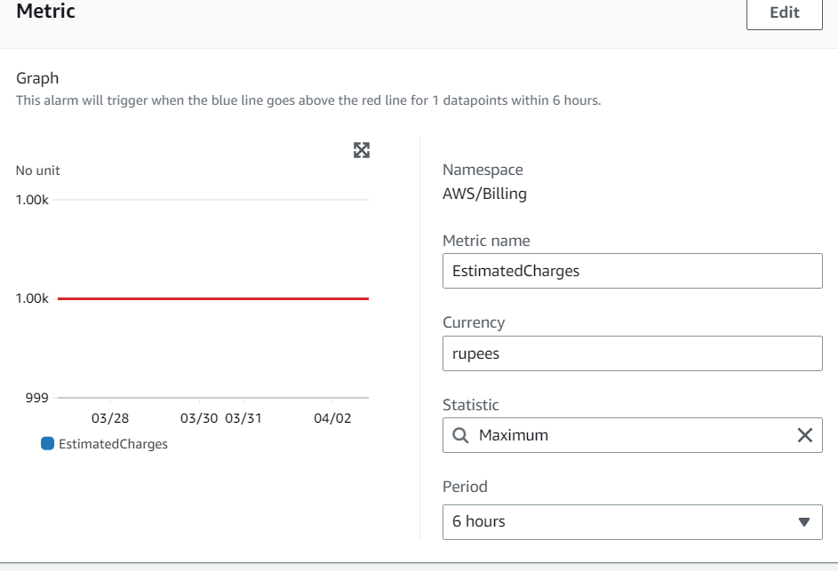
Now mention the amount for which if the billing crosses that particular amount it will send SMS via SNS i.e simple notification service.
Click on next.
In the notification panel select create new topic give a name for topic and also provide the email to which you want the notifications to be enabled and then click on create topic.

Slide 21
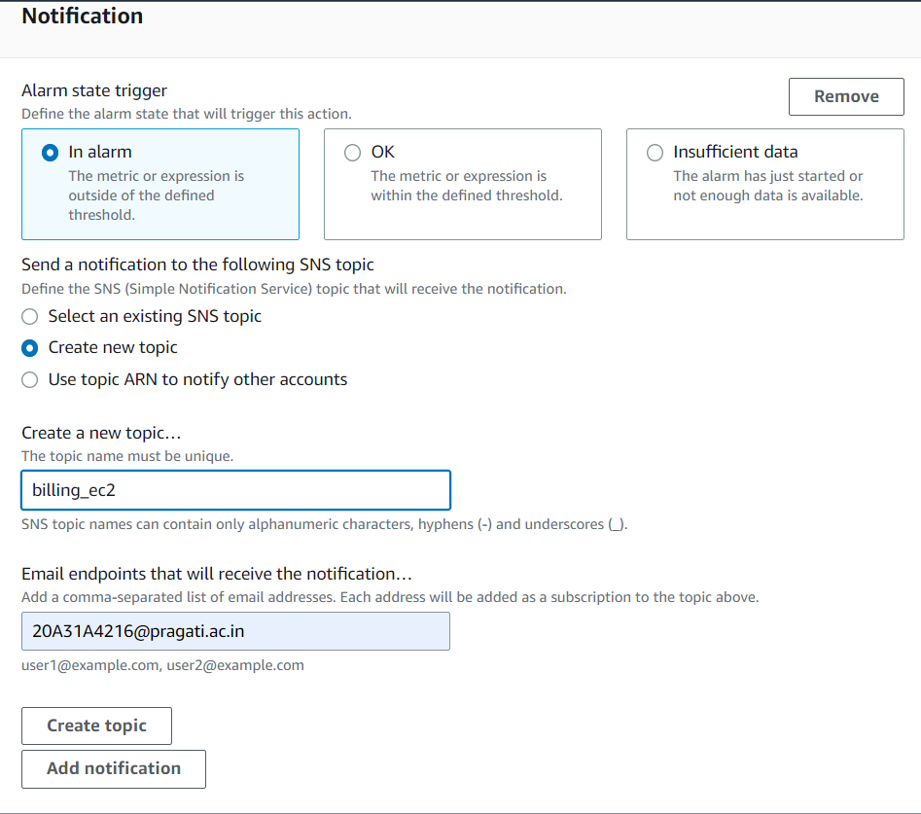
Click on next.
Give the alarm name and click on next and then create alarm.
you will see the popup for successful creation of alarm

